Slide 1
Fast Volume Rendering with Spatiotemporal Reservoir Resampling
Zhihao (ruanzh@seas.upenn.edu)
Shubham (sshubh@seas.upenn.edu)
Raymond (rayyang@seas.upenn.edu)
December 6, 2021

Slide 2
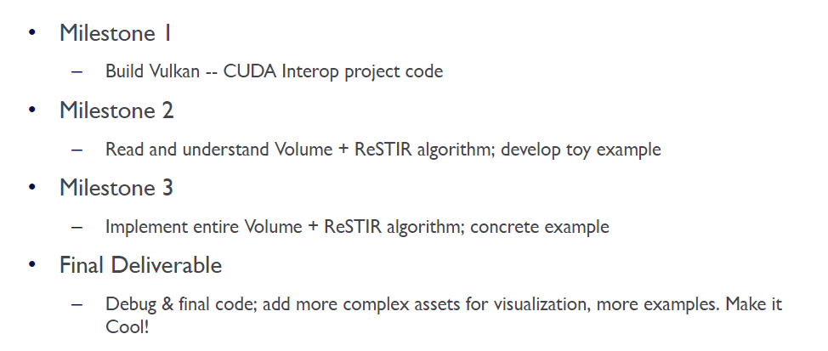
Milestones

Slide 3
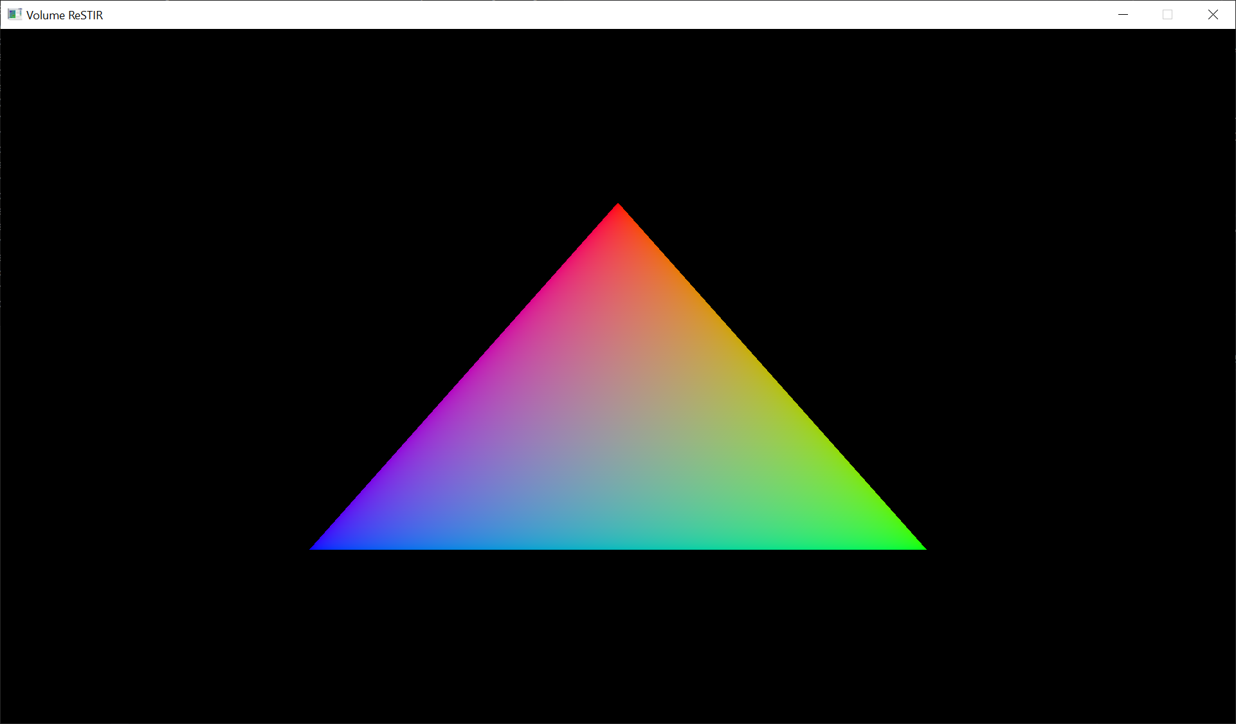
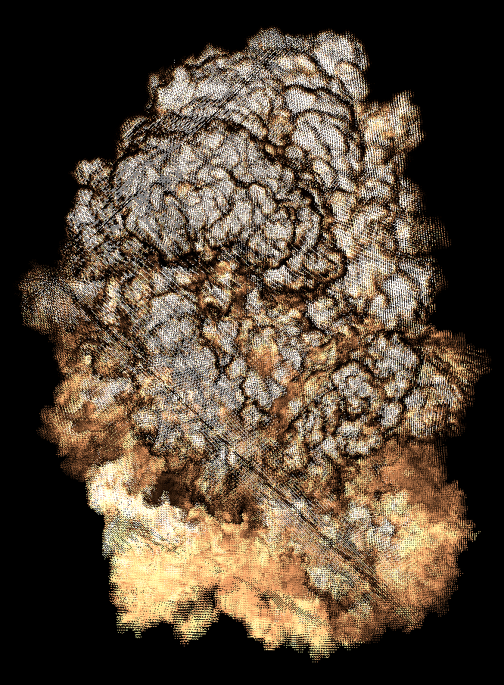
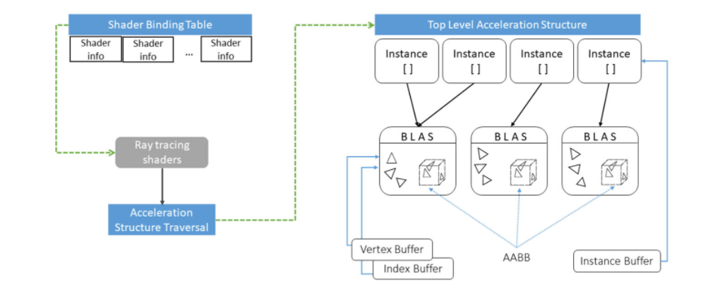
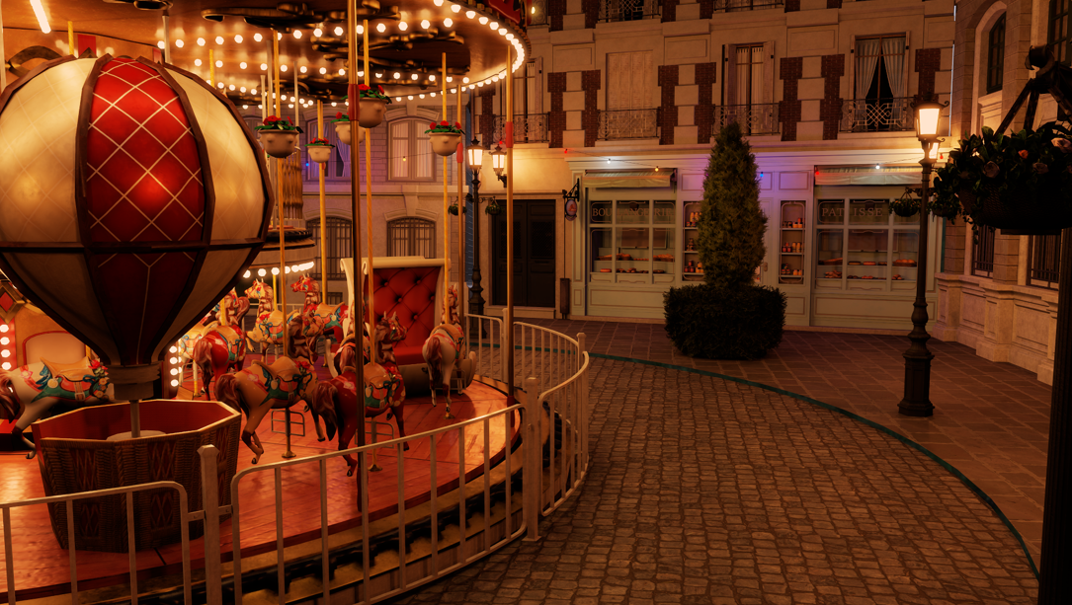

Overview of Project
01
Project Setup Steps
Basic Vulkan Pipeline
Vulkan Pipeline with Vertex/Index Buffers
OpenVDB Integration
02
Exploring Vulkan
Vulkan Ray Tracing Shaders
Vulkan TLAS & BLAS
Vulkan with OpenVDB Assets
03
Exploring ReSTIR and VDB with ReSTIR
Reservoirs, Lights, and other Structs
ReSTIR Algorithm
Adaptation of Algorithm for Volume Rendering
04
Last Minute Touch Ups
ReadME
Extend GUI’s Interactivity
Final Code Refactor

Slide 4
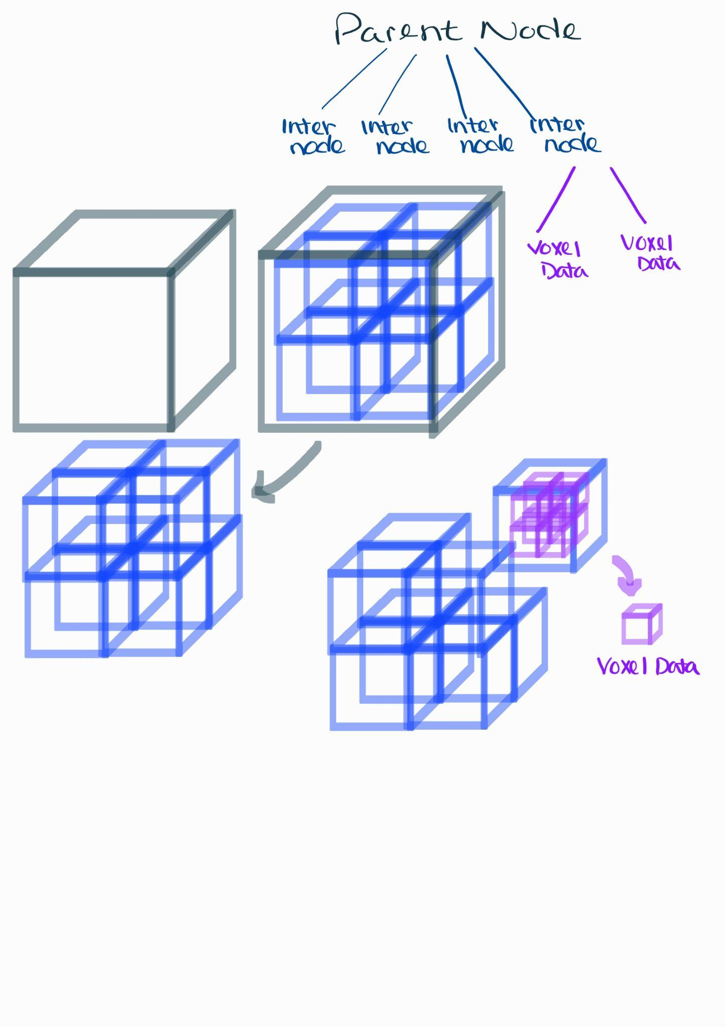
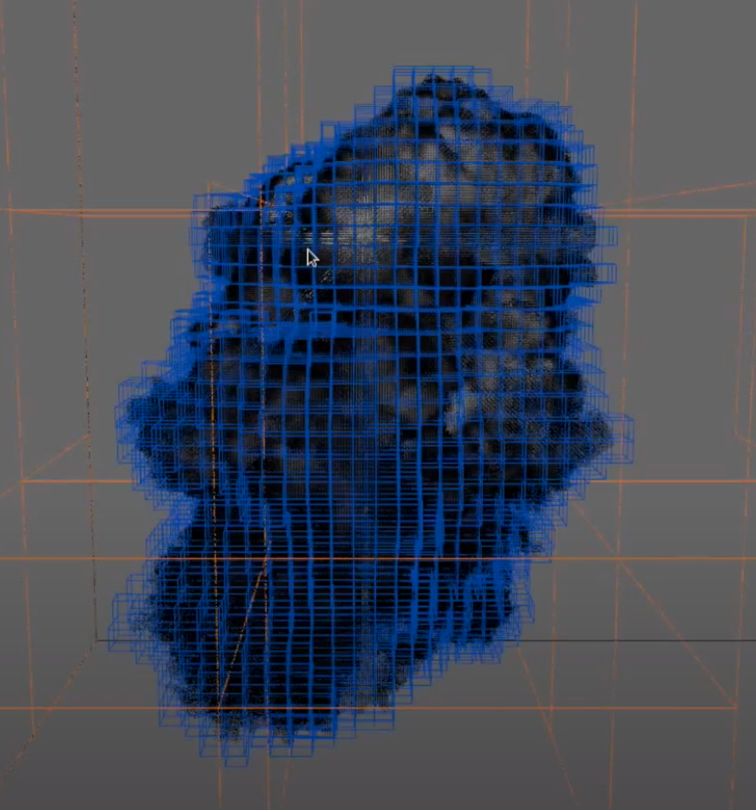
Overview OpenVDB

Slide 5
The Power of VDB
Fast random and sequential data access.
Memory efficient.
Adaptive resolution.
Dynamic

Slide 6
Overview ReSTIR
Fast Volume Rendering with ReSTIR
ReSTIR
PT Reservoir Sweep
eTriangle RT Shaders
Data Structures
Ray Tracing Shaders
OpenVDB TLAS/BLAS

Slide 7
What We Have Completed
Vulkan Rasterized Pipeline with Volumetric Assets.
Vulkan Path Tracing Pipeline with Volumetric Assets.
Vulkan Raytraced Restir Pipeline with GLTF. (Creating the Scene)

Slide 8
What We Have Left
Integrating Volume Restir Pipeline with with Volumetric Assets.

Slide 9
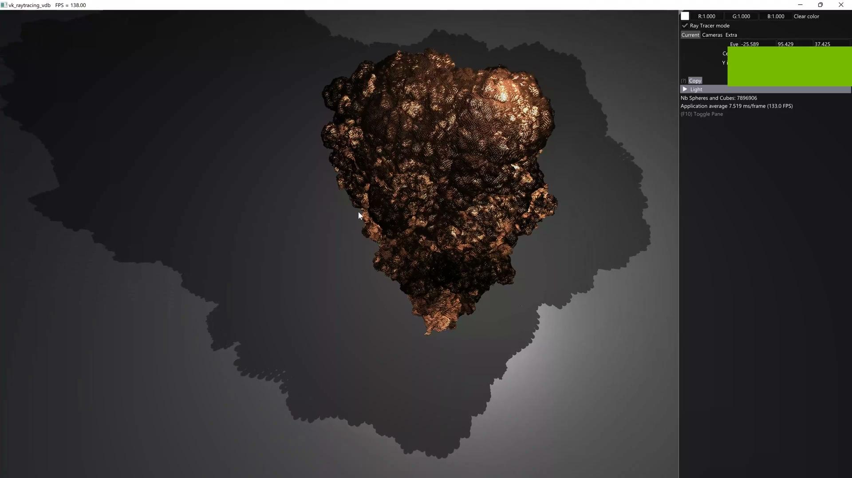
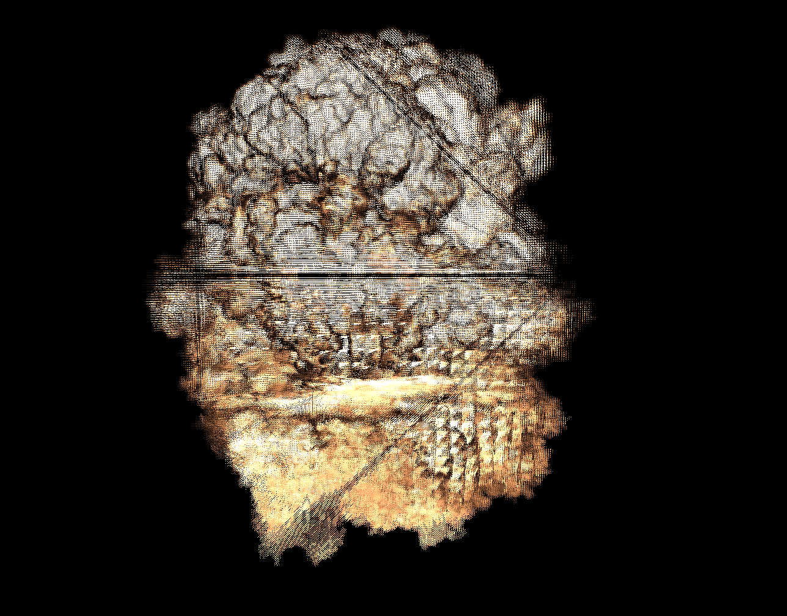
Path Traced Volume Rendering
Asset: Explosion
Voxel Count: 7,896,906
FPS: 133.0

Slide 10
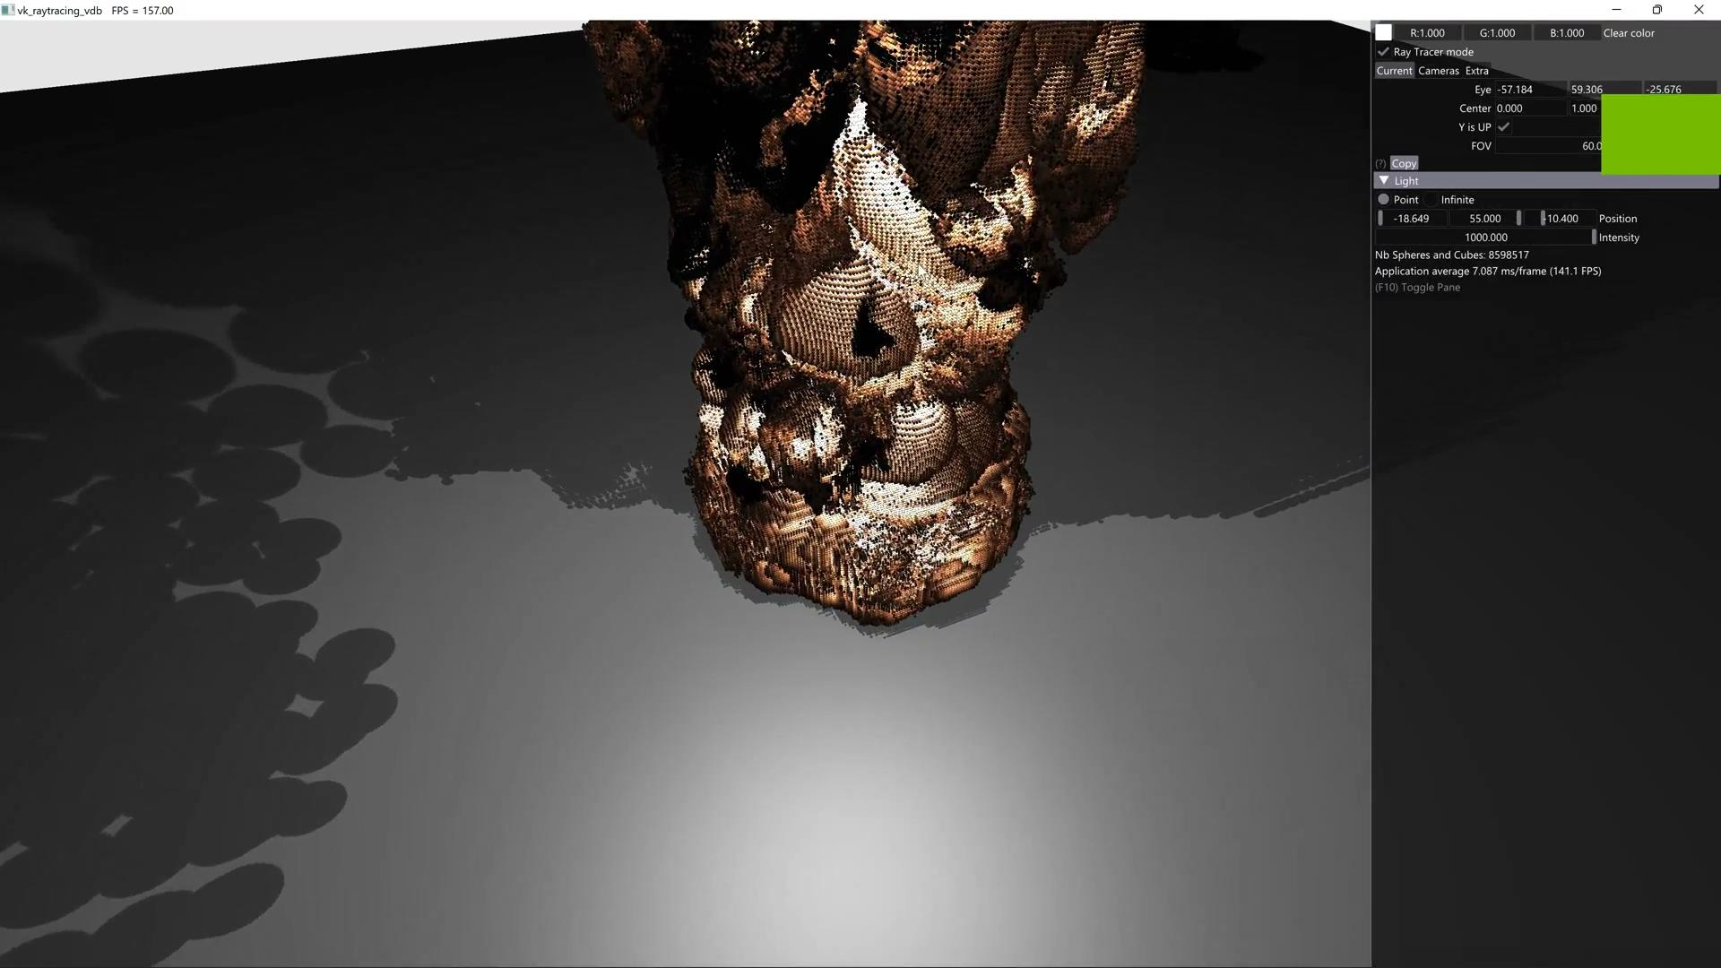
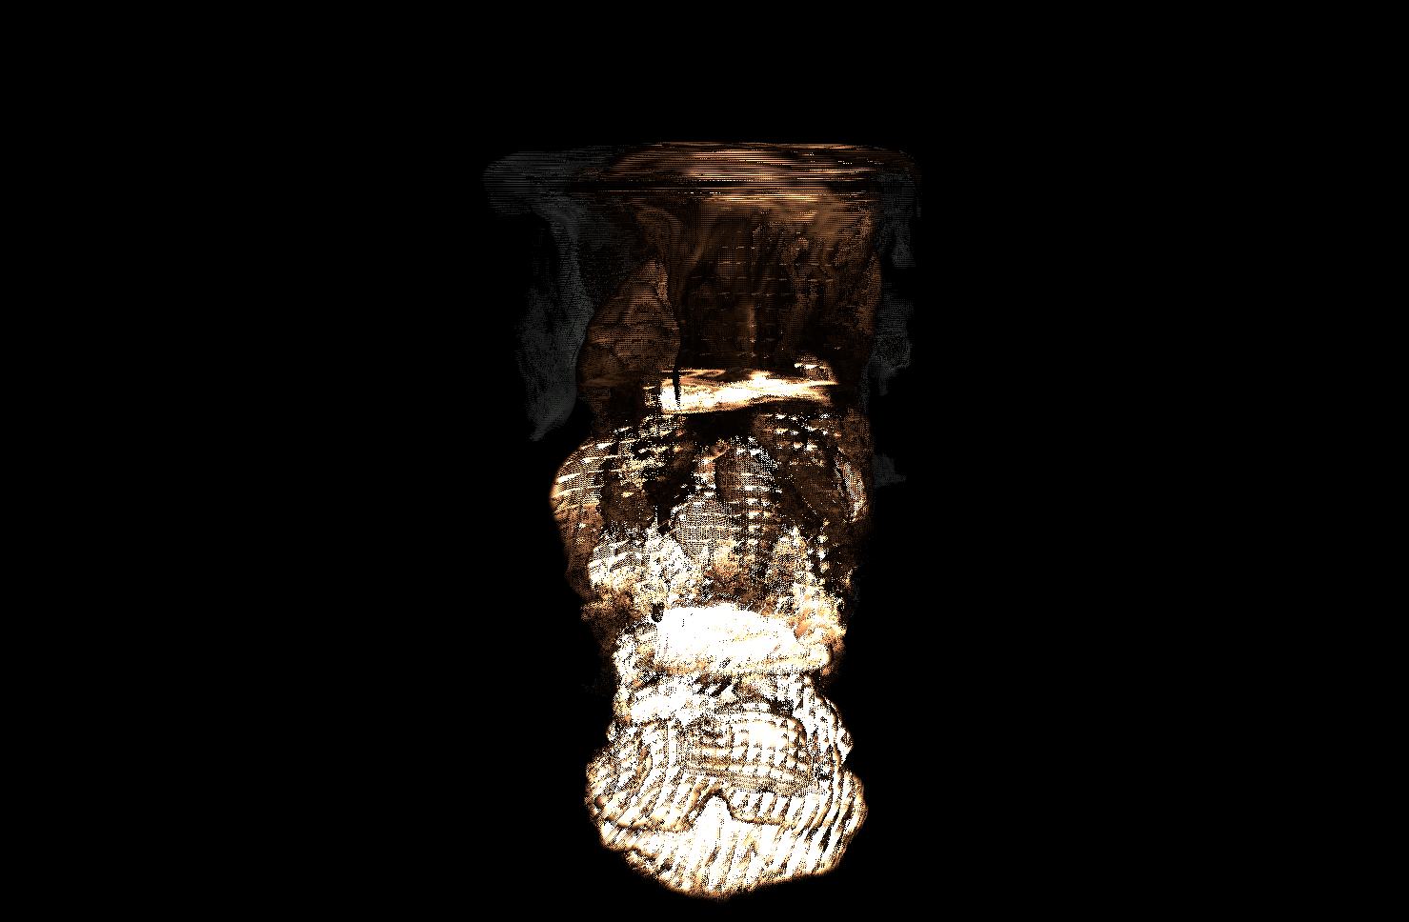
Path Traced Volume Rendering
Asset: Fire
Voxel Count: 8,598,517
FPS: 147.1

Slide 11
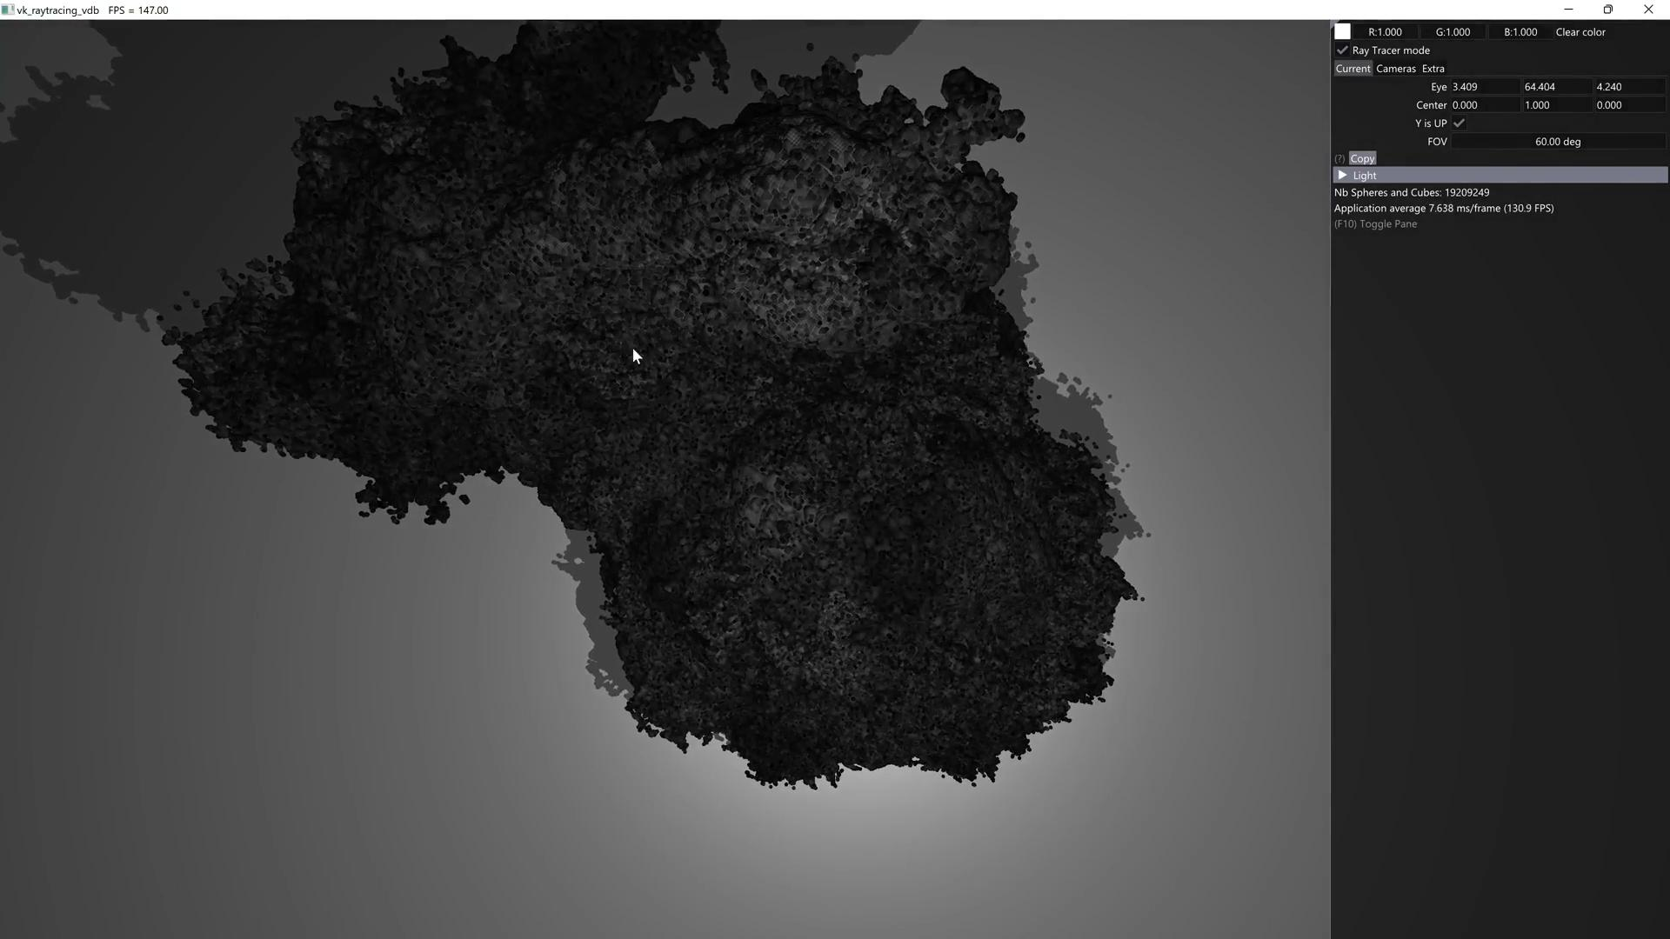
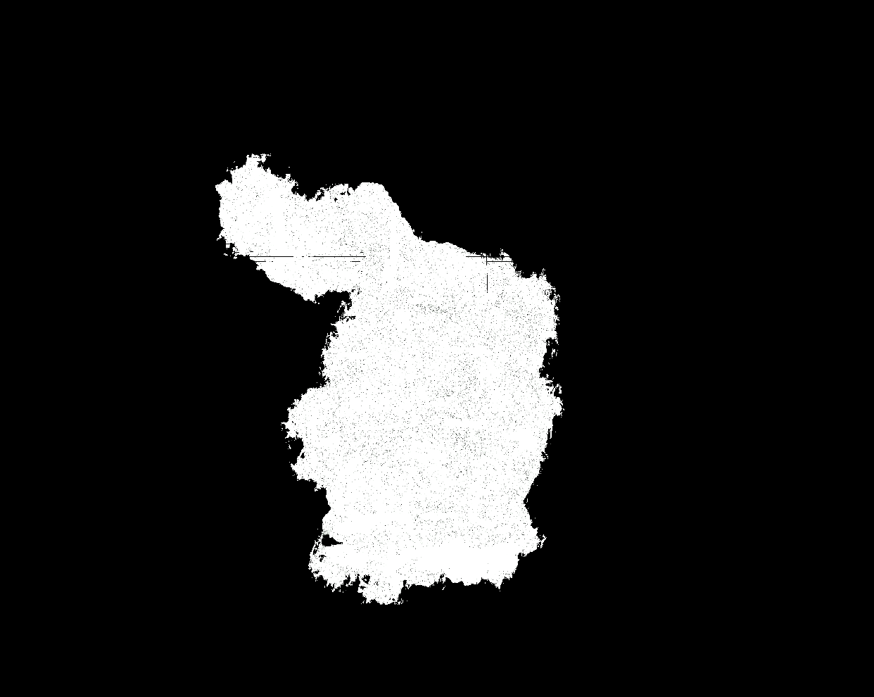
Path Traced Volume Rendering
Asset: Rabbit
Voxel Count: 19,209,249
FPS: 130.9

Slide 12
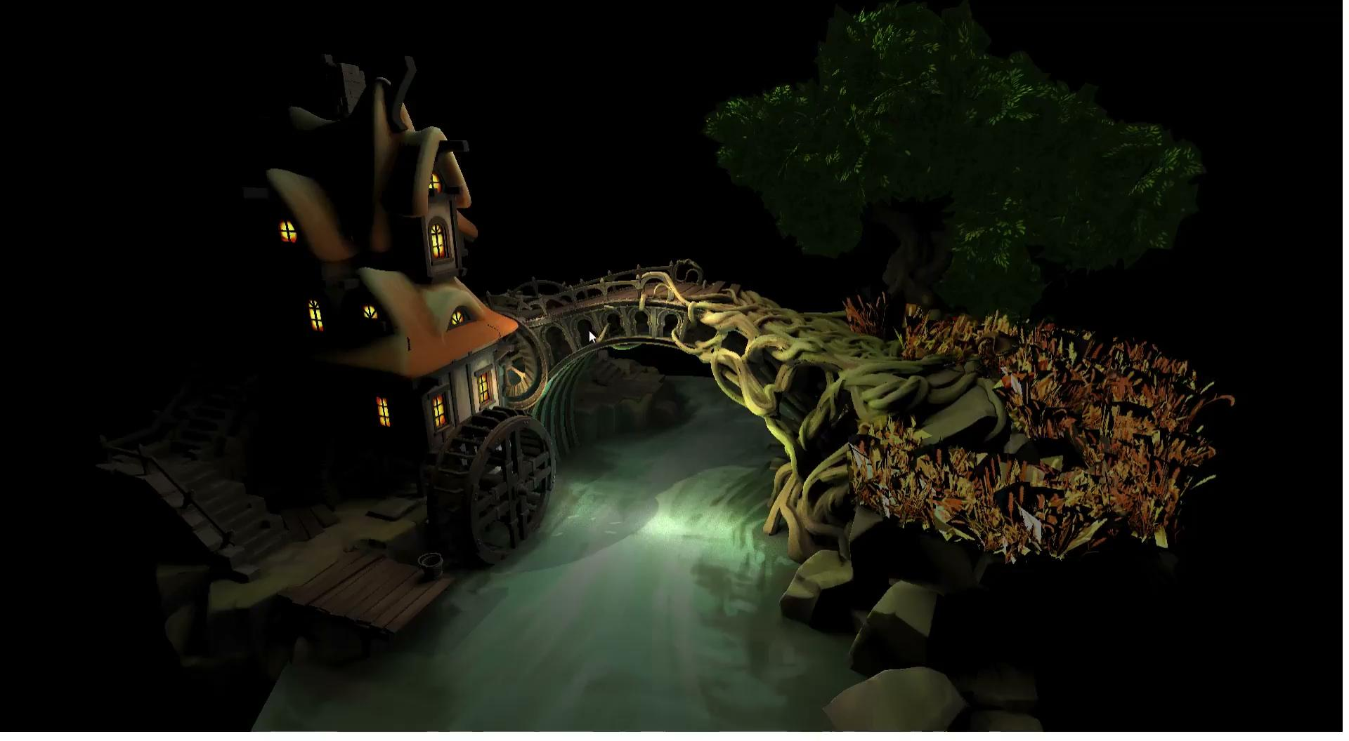
ReSTIR with GLTF Scene

Slide 13
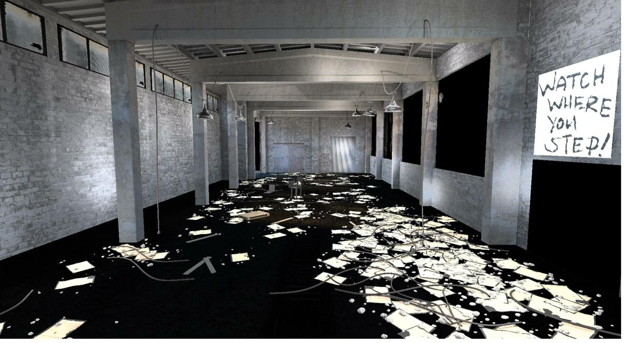
Restir with GLTF

Slide 14
Questions and Suggestions
Intersection Shader works with our vulkan raytraced pipeline but not with Restir Pipeline.

Slide 15
References
[1] Volume Rendering
[2] Volume Rendering (Nvidia)
[3] Ray Tracing Gems II
[4] Vulkan Ray Tracing with Intersection Shaders
[5] VK-Bootstrap
[6] OpenVDB
[7] Importance Resampling for Global Illumination

Slide 16
References
[8] Vulkan Ray Tracing Tutorial
[9] NVPRO Vulkan Mini Path Tracer
[10] Khronos Best Practices for Hybrid Rendering
[11] Spatiotemporal reservoir resampling for real-time ray tracing with dynamic direct lighting (SIGGRAPH 2020)
[12] Fast Volume Rendering with Spatiotemporal Reservoir Resampling (SIGGRAPH 2021)

